Slide 1
ResearchWhile
Dr. Taylor on his knee OA pilot research project
Division of Research update
Guidelines on reporting of research
Ming Tai-Seale
June 2, 2021

Slide 2
Overall Plan
Support
Support with time and research infrastructure
Encourage/mentor
Encourage/mentor EVERY faculty to
develop area of interest
partner with collaborators
join an existing research team
Encourage
Apply for time to do pilot projects
Expectation clarification
Set research expectations upon hiring
Promote
Promotion/switching requirements for
Promotion to Associate Professor
Positions in Clinical X series

Slide 3
Outcomes
Involvement in Practice-Based Research (PBR) or Learning Health Systems (LHS) study teams
Completion of pilot projects
Presentations (posters/oral) at regional/national meetings
Peer reviewed publications
Research funding

Slide 4
Current Research Division Services
Monthly Research Meeting – 3rd Wednesday 12-12:45pm for vetting ideas, escalations
Monthly “15~Minute ResearchWhile” during Faculty Meeting
Fund 2 pilot research projects in the remainder of 2021-2022
Strengthen collaboration with ACTRI, PHSO, IS, in PBR/LHS scholarship
Dr. Firestein spoke to us - ACTRI vouchers for faculty support
Dr. Agnihotri – will meet with research exec comm in July 2021
Support research paper writing / submission
Notes:
10 min
MPH students already have mentors.
Coaching students/trainees (MPH, MAS, MD, etc.) will take efforts. Involvement of primary instructors/mentors needs to be required so trainees get what they are supposed to receive for their training purposes..

Slide 5
Reporting Guidelines for Health Research: Why & How

Slide 6
Why
Transparency
Standardization
Scientific communication

Slide 7
How – A Few Options
Main Study Types | Reporting Guidelines | References
Randomized trials | CONSORT: Consolidated Standards of Reporting Trials | PMC2844943
Observational studies | STROBE: Strengthening the Reporting of Observational Studies in Epidemiology (STROBE) | PMID: 17938396
Quality improvement | SQUIRE: Standards for QUality Improvement Reporting Excellence | PMID: 26369893

Slide 9
Moher, et al., BMJ 2010;340:c869 doi: 10.1136/bmj.c869

Slide 10
Moher, et al., BMJ 2010;340:c869 doi: 10.1136/bmj.c869

Slide 11
Moher, et al., BMJ 2010;340:c869 doi: 10.1136/bmj.c869

Slide 12
Moher, et al., BMJ 2010;340:c869 doi: 10.1136/bmj.c869

Slide 13
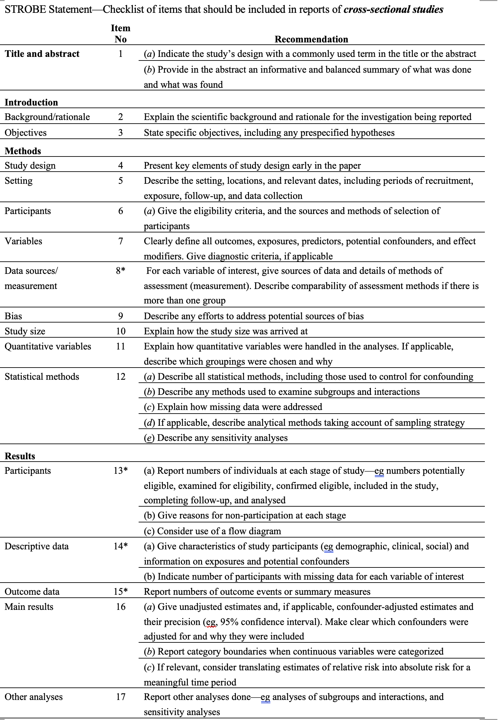
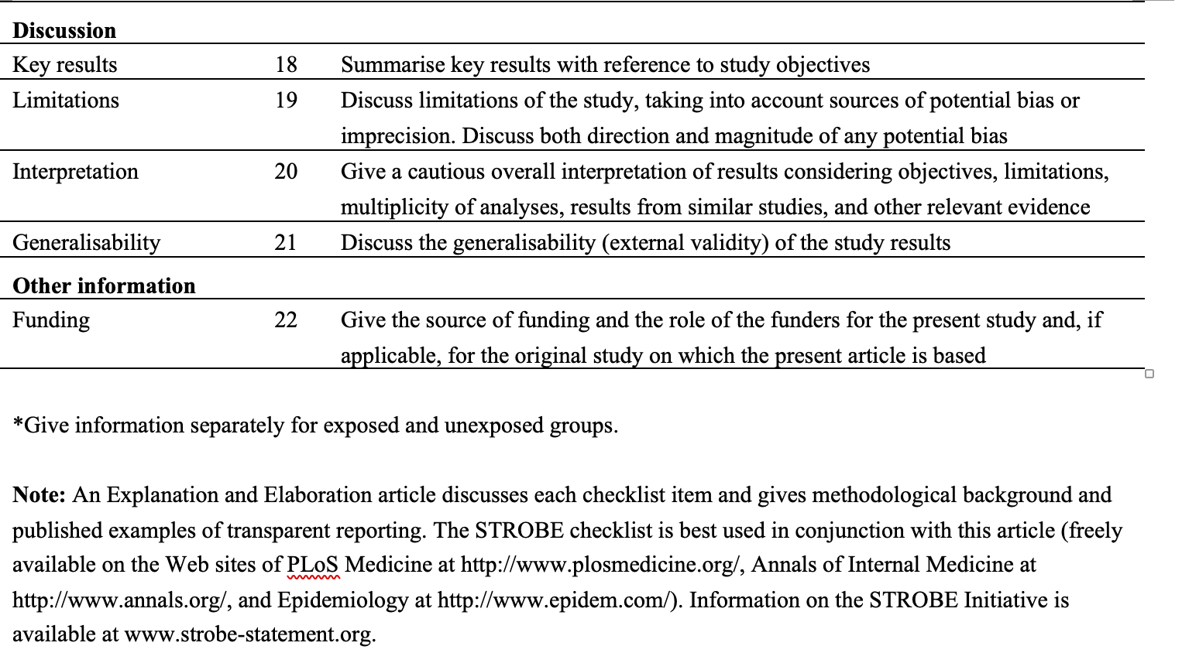
STROBE
von Elm et al. Ann Intern Med. 2007 Oct 16;147(8):573-7.
PMID: 17938396
DOI: 10.7326/0003-4819-147-8-200710160-00010
Observational Studies

Slide 14
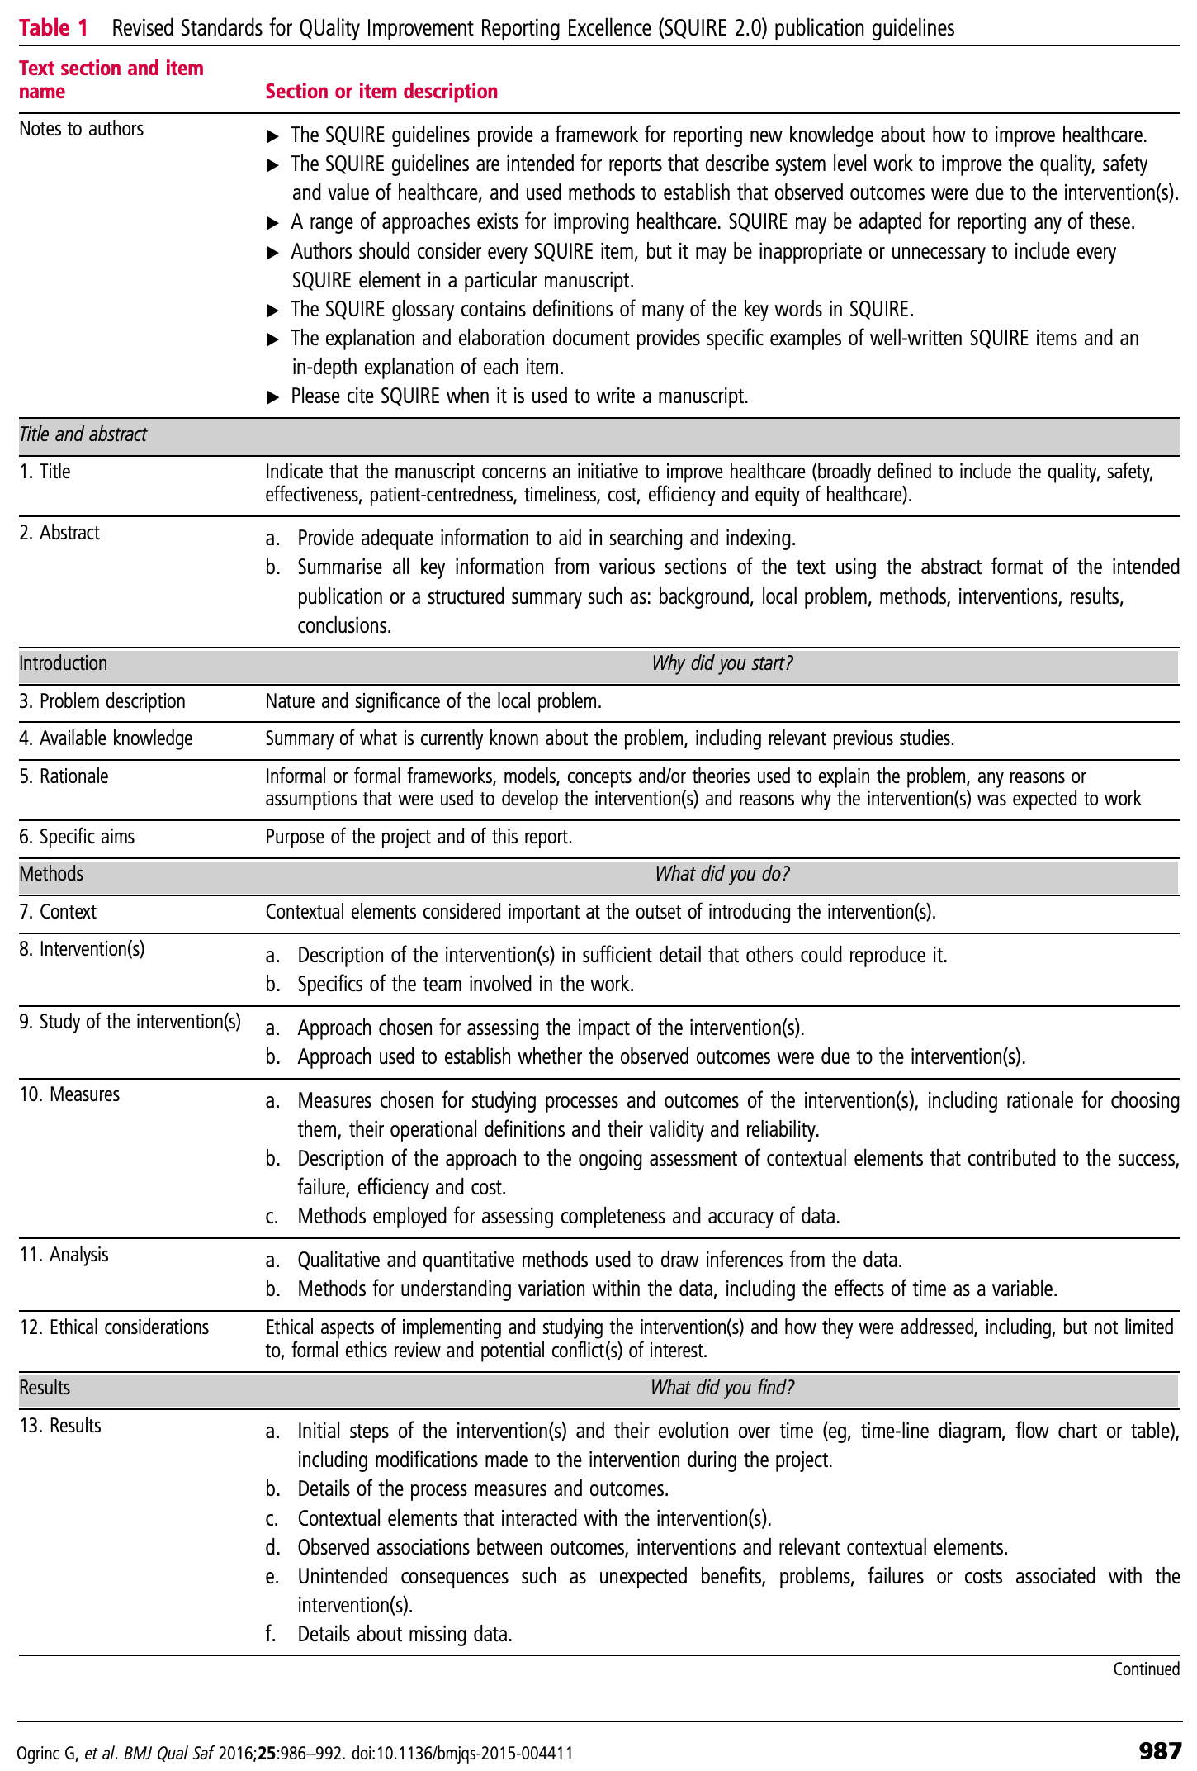
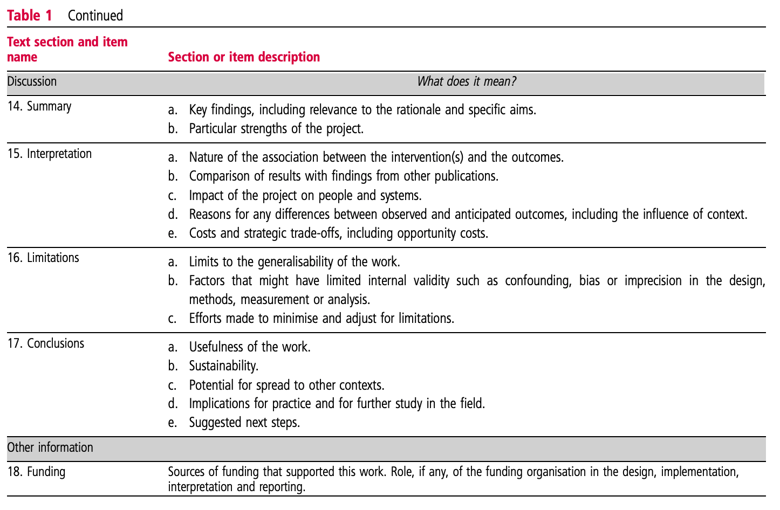
SQUIRE
Ogrinc G, et al. BMJ Qual Saf 2016;25:986–992. doi:10.1136/bmjqs-2015-004411, PMID: 26369893
Quality Improvement

